Slide 1

Aventure
Maya
Un projet ML-Agent

Slide 2
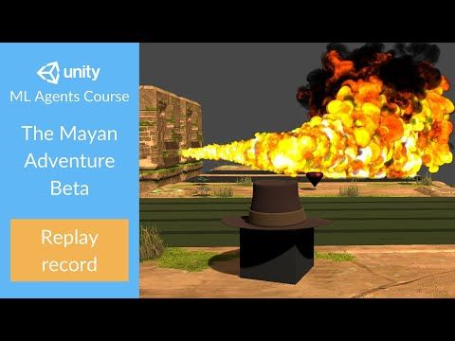

Slide 3
PROJET
(liens)
https://towardsdatascience.com/unity-ml-agents-the-mayan-adventure-2e15510d653b
https://github.com/simoninithomas/the_mayan_adventure
https://github.com/Unity-Technologies/ml-agents

Slide 4
AUJOURD'HUI
(liens)
https://intelligence.projet.autos/labo-agents/guide-temples-maya/
https://github.com/Unity-Technologies/ml-agents/tree/release_23
https://docs.unity3d.com/Packages/com.unity.ml-agents@4.0/

