Slide 1
Exemples de codes
de flocking
Donc comment programmer un boid ?

Slide 2
Comment
programmer le boid
en js

Slide 3
Principes de programmation d'un boid
Récupérer les boids du rayon d'influence (en utilisant une librairie)
Accumuler les valeurs (directions/distances) et faire une moyenne
Appliquer un delta à la valeur courante
Notes:
https://github.com/topics/flocking-simulation

Slide 4
DEMOS

Slide 5
Exemples déjà programmés (js)
Du plus simple…
Parasites
  Code : https://github.com/anuraghazra/parasites
  Demo : https://anuraghazra.dev/parasites/
Knaticat
  Code : https://github.com/knaticat/Flocking-Simulation
  Demo : https://knaticat.github.io/Flocking-Simulation/
QuadTree
  https://github.com/vharivinay/flocking-quadtree
  https://vharivinay.github.io/simulations/flocking/
Sans demo (mais bons)
  https://github.com/qema/neon-birds
Notes:
Simple Boid
Code : https://github.com/Niraj22/Flocking-simulation
https://github.com/topics/flocking-simulation
https://www.youtube.com/watch?v=2IVgz3pDmKc

Slide 6
Paramétré (js)
Boids
  Code : https://github.com/cubedhuang/boids
  Démo : https://boids.cubedhuang.com/
Jump of boids
  Code : https://github.com/jqlee85/boids
  Tutoriel : https://jumpoff.io/blog/implementing-boids-in-javascript-canvas
  Démo : https://jumpoffboids.netlify.app/
Flocking simulation with p5.js
  Code : https://github.com/tetzgabriel/flocking?tab=readme-ov-file
  Tutoriel : https://www.youtube.com/watch?v=mhjuuHl6qHM&t=2135s

Slide 7
avec serveur
Aquerium (serveur apache)
  Code : https://github.com/anuraghazra/EvolutionAquerium
  Démo : https://anuraghazra.dev/EvolutionAquerium/
  Article : https://anuraghazra.dev/case-studies/evolution-aquerium
Lightweight implementation (serveur node)
  Code : https://github.com/hughsk/boids
  Démo : https://hughsk.io/boids/

Slide 8
… plus complexes
Aquerium
  Code : https://github.com/anuraghazra/EvolutionAquerium
  Démo : https://anuraghazra.dev/EvolutionAquerium/
  Article : https://anuraghazra.dev/case-studies/evolution-aquerium
Flocking Black Hole
  Code : https://github.com/anuraghazra/FlockingBlackHole
  Démo : https://anuraghazra.dev/FlockingBlackHole/
  Vidéo : https://www.youtube.com/user/shiffman
  Challenge : https://thecodingtrain.com/CodingChallenges/144-black-hole-visualization.html
Coronavirus
  Code : https://github.com/anuraghazra/covid19-sim
  Démo : https://anuraghazra.dev/covid19-sim/

Slide 9
3D Birds
...au plus complexe
Flocking (birds)
  Code : https://github.com/ekelleyv/Flocking
  Démo : https://github.com/ekelleyv/Flocking
Three.js
  Code : https://github.com/mwcm/boids
  Démo : https://boids.mwcm.ca/
NVJOB Boids (Unity)
  Tutoriel : https://nvjob.github.io/unity/nvjob-boids
  Code and Démo : https://assetstore.unity.com/packages/3d/characters/animals/simple-boids-flocks-of-birds-fish-and-insects-164188
Black square Bird Flock (MIT license)
  https://github.com/black-square/BirdFlock
  Démo : http://black-square.github.io/BirdFlock/
Notes:
https://blog.yarsalabs.com/flock-simulation-using-boids-in-unity/

Slide 10
TUTORIELS

Slide 11
Tutoriels sur la programmation de flocking en js
https://jumpoff.io/blog/implementing-boids-in-javascript-canvas
https://gamedevelopment.tutsplus.com/tutorials/3-simple-rules-of-flocking-behaviors-alignment-cohesion-and-separation--gamedev-3444
http://www.kfish.org/boids/pseudocode.html
https://processing.org/examples/flocking.html
Avec éditeur web online :
https://thecodingtrain.com/CodingChallenges/124-flocking-boids

Slide 12
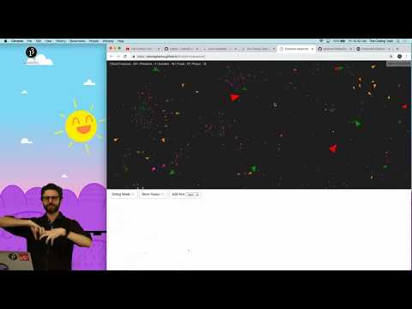

Slide 13
Exemple avec partie avancée
Flocking algorithm (par boardtobits)
  https://www.youtube.com/watch?v=mjKINQigAE4
  https://www.youtube.com/watch?v=i_XinoVBqt8
  https://www.youtube.com/watch?v=wyXAMfaG_IY
  https://www.youtube.com/watch?v=7LDFLMRGyqs
  https://www.youtube.com/watch?v=o9JdUYsPkzg
  https://www.youtube.com/watch?v=qzQZl09HDmI
  https://www.youtube.com/watch?v=-doZ2BGdwk8
  https://www.youtube.com/watch?v=kmwVDSUivkg
  https://www.youtube.com/watch?v=DbQjieYgAKA
  https://www.youtube.com/watch?v=e4dlp2YnVz8
https://github.com/boardtobits/flocking-algorithm

Slide 14
Exemples déjà programmés (Unity)
Du plus simple…
Flocking algorithm (par boardtobits)
  https://github.com/boardtobits/flocking-algorithm
  https://www.youtube.com/watch?v=mjKINQigAE4 (partie 1)
  https://www.youtube.com/watch?v=i_XinoVBqt8 (partie 2)
Flocking (MIT license)
  https://github.com/RafaelKuebler/Flocking

Slide 15
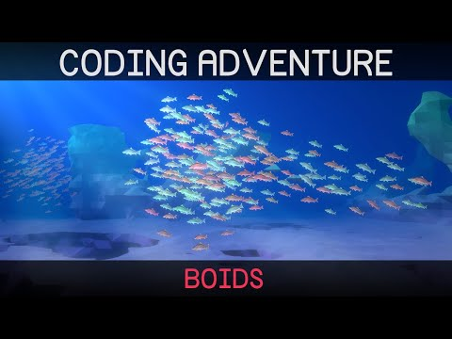
Exemple de Boid
Dans notre vie moderne
Notes:
https://en.wikipedia.org/wiki/Flocking_(behavior)

Slide 16
Tutoriels avec Unity
https://www.youtube.com/watch?v=e4dlp2YnVz8

Slide 17
RESSOURCES

Slide 18
Autres ressources
mouvements des agents autonomes
https://natureofcode.com/book/chapter-6-autonomous-agents/

Slide 19
Ressources Unity
Oiseaux
  https://assetstore.unity.com/packages/3d/characters/animals/birds/imperial-penguin-100397
Poissons
  https://assetstore.unity.com/packages/3d/characters/animals/fish/sardine-37963
Variés pour flock
  https://assetstore.unity.com/packages/3d/characters/animals/nvjob-simple-boids-flocks-of-birds-fish-and-insects-164188
Notes:
// [HelpURL("https://nvjob.github.io/unity/nvjob-boids")]
// [AddComponentMenu("#NVJOB/Boids/Simple Boids")]
[Header("Information")] // These variables are only information.
public string HelpURL = "nvjob.github.io/unity/nvjob-boids";
public string ReportAProblem = "nvjob.github.io/support";
public string Patrons = "nvjob.github.io/patrons";
// Copyright (c) 2016 Unity Technologies. MIT license - license_unity.txt
// #NVJOB Simple Boids. MIT license - license_nvjob.txt
// #NVJOB Nicholas Veselov - https://nvjob.github.io
// #NVJOB Simple Boids v1.1.1 - https://nvjob.github.io/unity/nvjob-boids

